Slide 1

BREWSTATS ANALYSIS
Brewing Connections, One Cup at a Time

Slide 2


Performance Analysis Overview: Coffee Shop Locations
This data-driven analysis explores the performance of a three-location coffee shop chain - Astoria, Hell’s Kitchen, and Lower Manhattan, by examining key business metrics aimed at uncovering revenue opportunities and improving overall product and store performance.
The insights are drawn from a variety of factors, including foot traffic based on transactions, total revenue per location, and top five product categories, helping to identify what drives customer engagement and sales at each store. Additionally, an in-depth look at daily sales trends, peak operating hours per store, and revenue per transaction provides a clearer understanding of customer behaviour and purchase patterns.
The analysis further includes revenue per quantity sold and monthly revenue performance, offering a broader view of profitability and sales efficiency over time. Together, these insights aim to guide strategic business decisions related to product optimization, staffing, promotions, and operational improvements to increase revenue and drive sustainable growth.

Slide 3
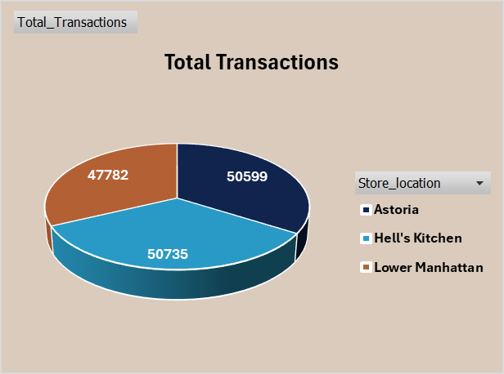
Foot Traffic based on number of Transactions per store
This analysis examines the volume of customer transactions at each store location to gauge foot traffic and overall store popularity. By evaluating the number of transactions, we can identify high-performing branches, understand customer behaviour patterns, and pinpoint peak operating times. These insights are essential for optimizing staffing, improving inventory management, and enhancing customer service during high-demand periods.

Slide 4
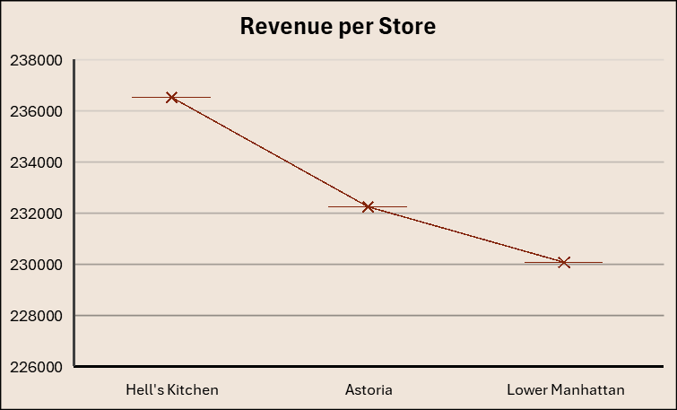
Total Revenue per Store location
This analysis focuses on the total revenue generated by each store location, providing a clear comparison of financial performance across branches. By identifying which locations contribute the most to overall sales, we gain insight into customer spending behaviour, store profitability, and potential areas for growth or improvement. These findings support strategic decision-making related to resource allocation, marketing focus, and expansion planning.

Slide 5
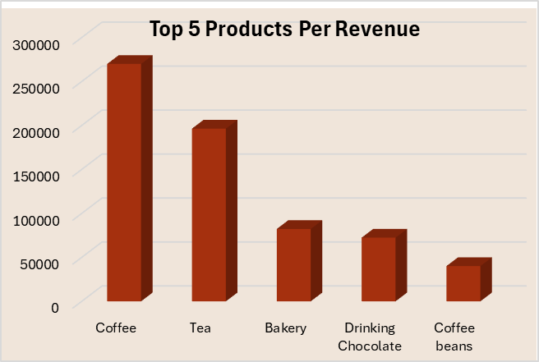
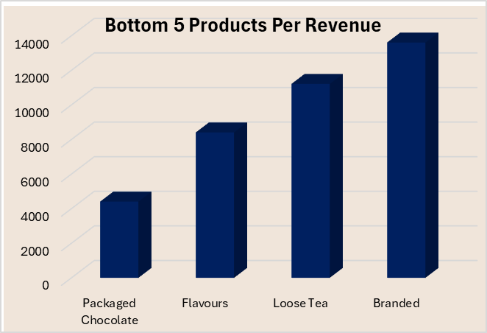
This analysis highlights the top and bottom five product categories based on total sales performance across all store locations. By identifying which categories drive the most revenue and which underperform, the report provides valuable insights into customer preferences, product demand, and inventory effectiveness. These findings can inform purchasing decisions, promotional strategies, and product placement to enhance overall sales performance.
Best and Least Performing Product Categories

Slide 6
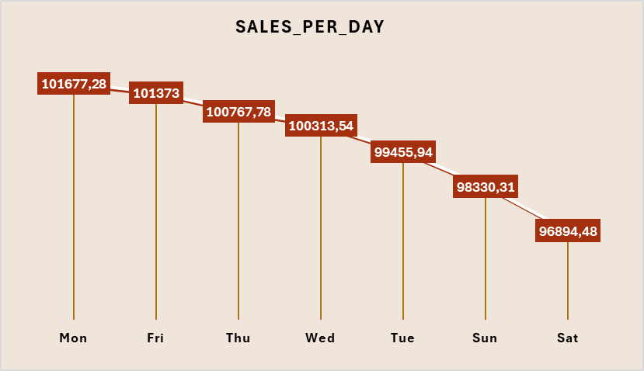
Daily Sales Performance
This section analyses daily sales performance across all three coffee shop locations - Astoria, Hell’s Kitchen, and Lower Manhattan. By examining sales volume and revenue trends on a day-by-day basis, the analysis identifies which days consistently generate the highest and lowest sales.
Key observations include patterns in weekday vs. weekend performance, peak sales days, and potential dips that may suggest operational inefficiencies or missed opportunities. Understanding these daily trends enables better planning for staffing, inventory, and targeted promotions, ultimately helping to increase revenue and improve overall customer experience.

Slide 7
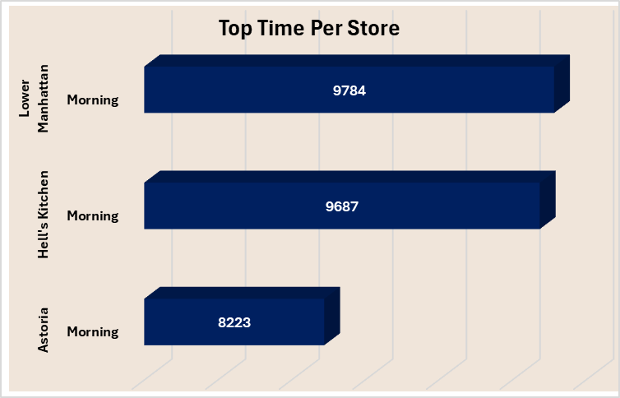
Peak Transaction Times by Location
This analysis segments daily sales by sold quantity across three-time intervals: Morning, Afternoon, and Evening. The data reveals that morning hours consistently record the highest number of transactions across all store locations, indicating a strong early-day customer presence. Understanding this pattern allows for better planning in staffing, inventory restocking, and targeted morning promotions to maximize sales and improve customer service during peak hours.

Slide 8
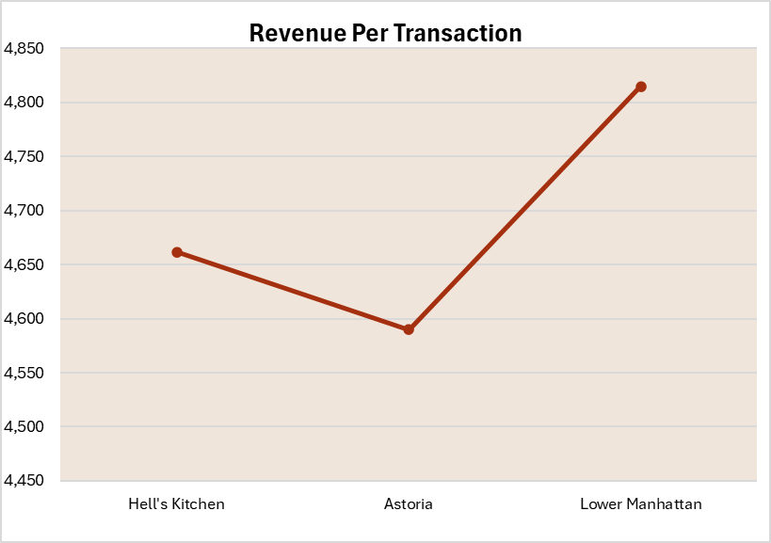
Average Revenue per Transaction
This analysis measures the average amount of revenue generated from each transaction across store locations. Tracking average revenue per transaction provides valuable insight into customer purchasing behaviour and sales effectiveness. Understanding these patterns helps identify opportunities to increase basket size through targeted promotions, pricing strategies, and product placement, ultimately driving higher store profitability.

Slide 9
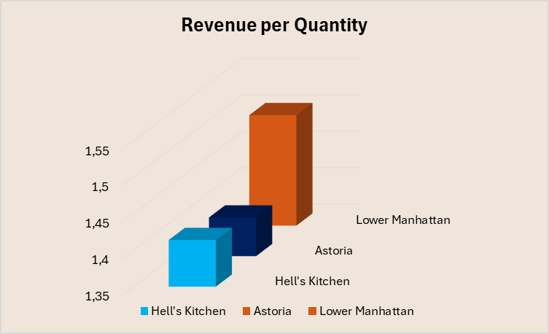
Average Revenue per quantity
This analysis calculates the average revenue earned for each unit of product sold across all store locations. By understanding the revenue generated per quantity, the report sheds light on pricing effectiveness and product mix profitability. Insights from this metric can guide pricing strategies, inventory decisions, and promotional efforts to maximize revenue while maintaining competitive product offerings.

Slide 10
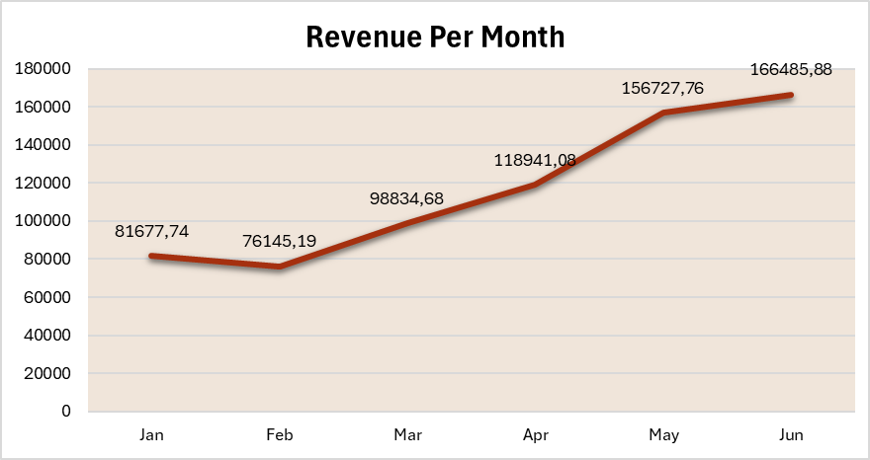
Revenue per month
This analysis tracked total revenue generated each month across all store locations to identify sales trends and seasonal patterns. Monitoring monthly revenue helps uncover periods of high and low sales performance, enabling informed decisions around marketing campaigns, inventory management, and resource allocation to optimize profitability throughout the year.

Slide 11




